Slide 1

Unit 4
“Authority, State & Religion”

Slide 2
Starter
Today we are going to look at the last unit called ‘Authority, State & Religion’
We have touched upon:
‘Religion and conflict’
‘Religion and medicine’
‘Religious expression’
This is the final unit for us to look at. Next week we will be back to paper and practicing writing some model answers.

Slide 3




Sacred texts
Clashes of authority
Capital punishment
Injustice/Punishments
On the next slide create a table of revision notes on this topic (if you prefer this can be printed and written on)

Slide 4
Key terms | Meanings
Duty | Something you must do or furfil
Justice | Equal rights
Human Rights | Every human is equal
Personal conviction
Notes:
This will be double sided with the following slide

Slide 5

Topics in ‘Authority and state’ | Christian | Catholics | Islam (Muslim)
What do they think about human rights?
Should capital punishment be allowed? | Try to add attitudes and Bible teachings too |  | There are arguments for and against this
How are sacred texts use? Why important? | (Also try to see say what a believer might do if the law clashed with their beliefs. Any examples?)
How should people be punished? What do they say about injustice? | Think about what the aims of some punishments are
Notes:
This will be double sided with the following slide

Slide 6


Why do people keep the law?

Slide 7


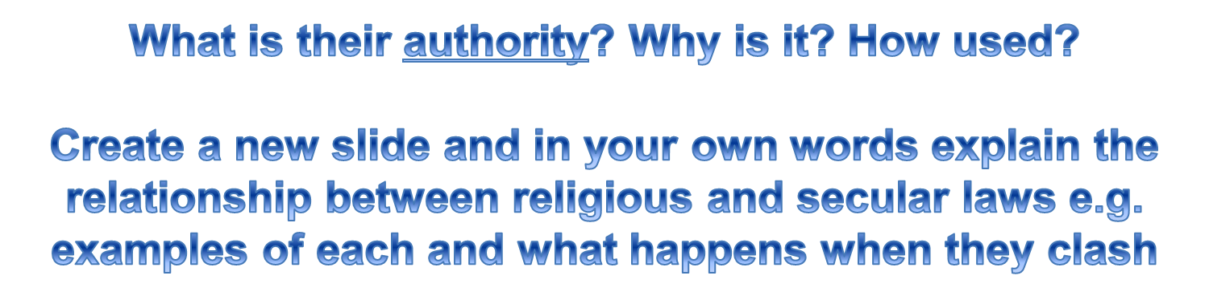
Write short answers underneath the heading
Christian
Catholics
Muslims

Slide 8
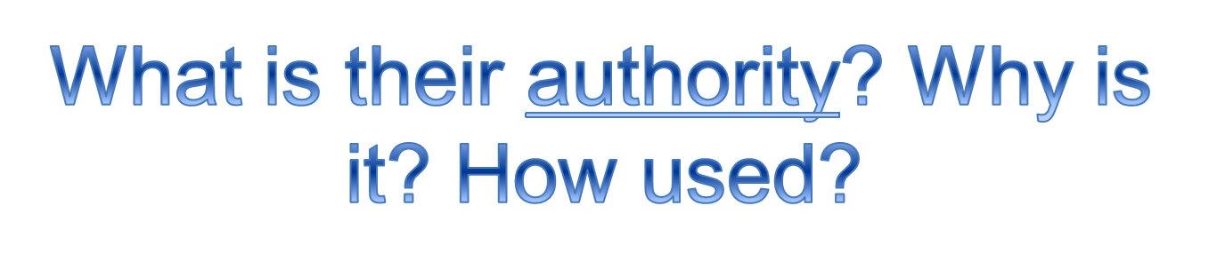
In Christian religion is the bible. They think that this is the word of

Slide 9


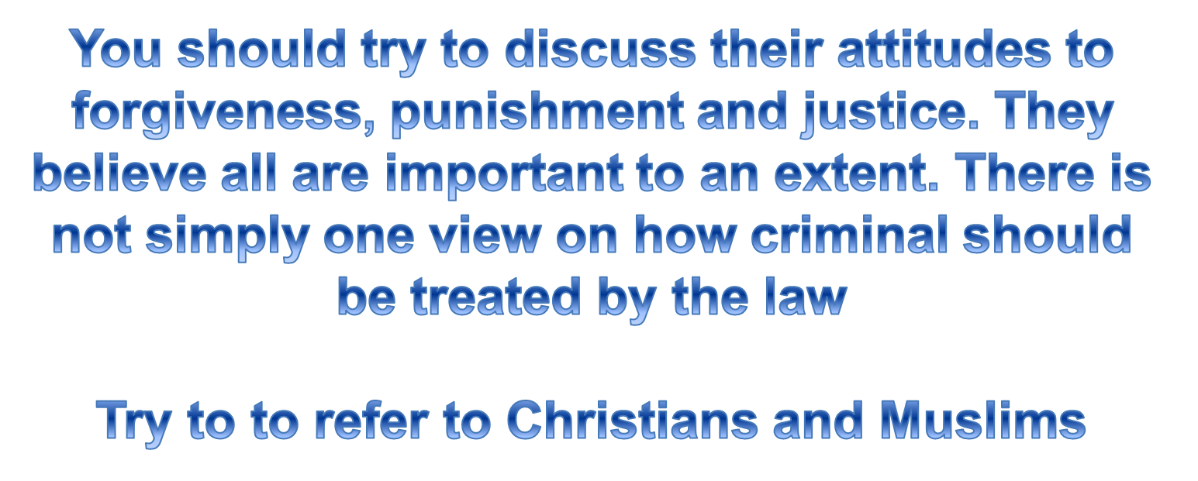
Explain how a believer’s attitude to punishment might be influenced (4)
Notes:
Make a new slide for your answers

Slide 10


Complete a powerpoint on how Martin Luther King and Oscar Romero tried to bring about justice. What was their motivation? How were their actions influenced by their Christian beliefs
Notes:
Think about including key terms and religious vocabulary where possible!

